Slide 1
Introduction to Object-Relational Mapping for DBAs
Christopher Cumming
Saturday Morning Productions

Slide 2
SQL Summit
Annual International Conference
November 6 -9 | Seattle, WA
2 Days of Pre-Cons
200+ sessions over 3 days
Over 5,000 SQL Professionals
Evening Networking Activities

Slide 3














Please Support Our Sponsors

Slide 4



Let’s Not Distract Others
Please silent your phone
We can chat later
Please don’t snore

Slide 5
Slides and Example Code
https://github.com/saturdaymp/IntroductionToORMForDBAs

Slide 6


Who am I? (i.e. Shamless Self Promotion)
Saturday Morning Productions
Owner/Consultant http://saturdaymp.com
chris.cumming@satudaymp.com
Edmonton .NET Users Group Program Director http://edmug.net
info@edmug.net

Slide 7
What is Object-Relational Mapping?
Wikipedia Definition
Object-relational mapping (ORM, O/RM, and O/R mapping tool) in computer science is a programming technique for converting data between incompatible type systems using object-oriented programming languages. This creates, in effect, a "virtual object database" that can be used from within the programming language. There are both free and commercial packages available that perform object-relational mapping, although some programmers opt to construct their own ORM tools.
My Definition
Map relational data to objects.

Slide 8
What is an Object?
An object is an instance of a class.
What is a Class?
Defines the initial state of an object and it’s behaviours.

Slide 9
Example of a Class
public class Car
{
public Color ExternalColor { get; set; }
public Sound HornSound { get; set; }
public Current Speed { get; }
public void HonkHorn(Time timeToHonk);
public void PushPedal(Force forceOnPedel);
}

Slide 10
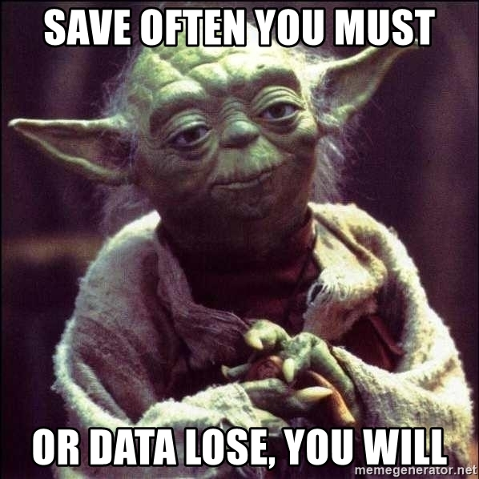
Save Often

Slide 11
DRY – Don’t Repeat Yourself
Good developers are like good DBAs. We don’t like to repeat ourselves.

Slide 12
What is Covered in the Demo?
Code First
Migrations
Convention over Configuration
Lazy Loading vs Eagar Loading
Unit of Work
Complex Queries

Slide 13
Learn More
Slides and Example Code
https://github.com/saturdaymp/IntroductionToORMForDBAs
ASP.NET Core MVC with Entity Framework Tutorial
https://docs.microsoft.com/en-us/aspnet/core/data/ef-mvc/intro?view=aspnetcore-2.0
Contact Me:
chris.cumming@saturdaymp.com @saturdaymp

